Slide 1
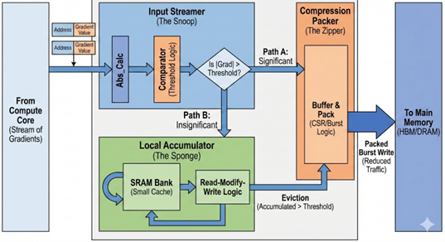

Cognichip Hackathon: EcoTraining: An Energy-Efficient Hardware Design for Gradient Compression in LLM Training
Team Name: Train Neo Bit
Proposed Innovation: The Gradient Compression Unit (GCU)
Project Overview:
We propose to design a Gradient Compression Unit (GCU), a specialized hardware accelerator that mitigates the "Memory Wall" in AI training. Our innovation is a "near-data" architectural shim that exploits temporal sparsity. The GCU intercepts gradient streams before they hit the memory bus, filtering out insignificant updates ($\left|∇W\right|<ε$) and aggregating them in a local "Error Feedback Buffer." Only when accumulated gradients become statistically significant does the "Compression Packer" burst-write them to High-Bandwidth Memory (HBM).
Team Members (2-4 per team): [Feiyu Jia, 2001, fj2182@nyu.edu, Assistant Director]
[Heng Pu, 1999, hp2723@nyu.edu, Assistant Director]
[Lixuan Xu, 2003, lx2349@nyu.edu, Assistant Director]
[Yuhan Jiang, 2003, yj3494@nyu.edu, Assistant Director]
Methodology:
We will leverage Generative AI to accelerate two hardware design:
RTL Generation for Complex Protocols: The "Compression Packer" requires a complex FSM to handle AXI4 burst alignment and sparse-data packing.
Synthetic Workload Modeling: Validating this hardware requires realistic data. We will generate scripts that produce “synthetic gradient streams” mimicking the statistical distribution.
Problem Domain:
We are currently witnessing an exponential growth in the computational demands of Artificial Intelligence. Modern Foundation Models (like GPT-4, Llama 3, or Claude) have scaled from millions to trillions of parameters. While specialized hardware (GPUs/TPUs) has successfully scaled up compute performance (FLOPS), the memory systems have not kept pace. This divergence has created the "Memory Wall," where the speed of training is no longer limited by how fast we can do math, but by how fast we can move data between the processor and High-Bandwidth Memory (HBM).
Our project focuses specifically on the Backward Pass (Weight Update) phase of AI training. Solving this doesn't just make training faster; it makes it accessible. By reducing the bandwidth requirements for training, we allow larger models to be fine-tuned on commodity hardware (like edge devices or older GPUs) rather than requiring massive HBM clusters.
Testing & Demonstration:
The final deliverable will be a synthesizable SystemVerilog IP core. We will demonstrate its value through a comparative simulation:
Baseline: A standard write-back trace (100% bandwidth usage).
Innovation: The GCU trace processed with our AI-generated workloads.
Success Metric: We aim to demonstrate a >50% reduction in memory write transactions with minimal area overhead. As a stretch goal, we will use AI to explore and implement a "Stochastic Rounding" logic block to further improve convergence stability.

